Slide 1
NOTE
This file contains the PowerPoint presentation for the significant changes to the JFMM. It has been designed to be supported by the associated training notes document (JFMM_Training_Notes.docx). The pages of this file correspond to the Word document file included on this JFMM edition.
1

Slide 2
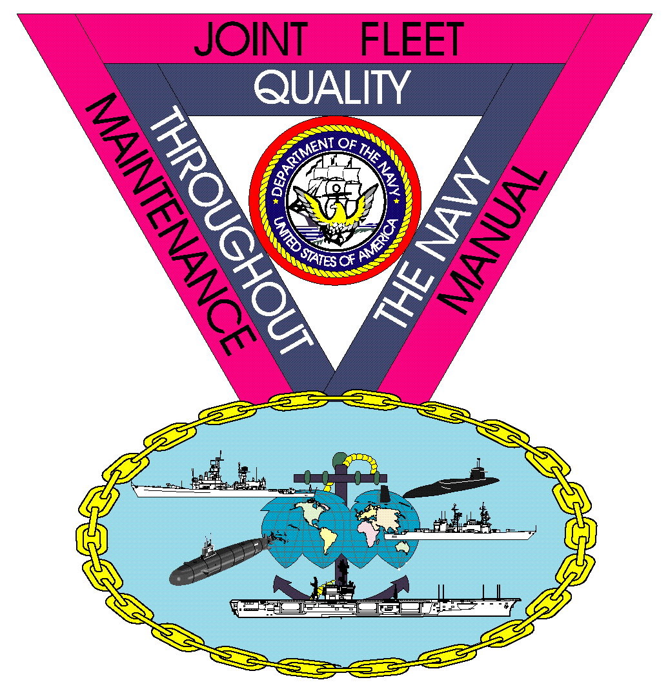
COMUSFLTFORCOMINST 4790.3
Rev D Change 5
2

Slide 3
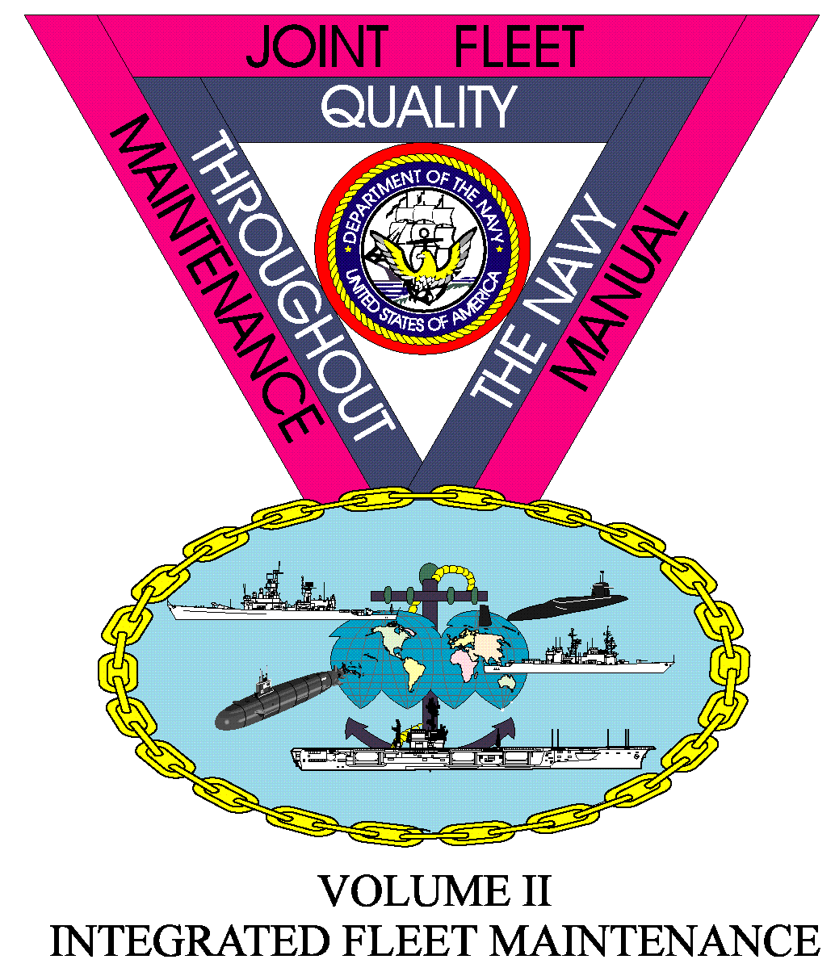
JFMM Foreword
3

Slide 4
Foreword
Terminology
Clarified the terminology between being an applicable “Surface Force” TYCOM ship from a “surface ship”.
Added “Aegis Ashore” to JFMM applicability.
Delineated Aegis Ashore TYCOM and ISIC
To Commander Naval Surface Force Atlantic
Foreword, Paragraph 5.1; Foreword, Paragraph 5.3;

Slide 5
JFMM Volume I
NEW CONSTRUCTION
5

Slide 6
New Construction
Certifications
Added HM&E Control System Certification Process.
Volume I, Chapter 3, Paragraph 3.3.17;

Slide 7
JFMM Volume II
INTEGRATED FLEET MAINTENANCE
7

Slide 8
Maintenance and Modernization Program
Naval Supervisory Authority
Aligned AIT and Modernization Programs.
Quality of Service
Added Quality of Service to NSA and LMA responsibilities.
Navy Modernization Process (NMP)
Aligned AIT and Modernization Programs.
Volume II, Part I, Chapter 2, Paragraph 2.1.1; Volume II, Part I, Chapter 2, Paragraph 2.1.2; Volume II, Part I, Chapter 2, Paragraph 2.6;
8

Slide 9
CNO Scheduled Maintenance Availabilities
Chapter Updated
Review the entire chapter specifically for:
Command, Control, Communications, Computer, Combat Systems (C5I) Intelligence Light Off (C5ILO) and SOVT
Updated C5ILO and SOVT as a key event.
Quality of Service, Habitability and Livability
Added requirements for QoS and QoSC.
Days of Maintenance Delay
Updated methods of calculation and realized DoMD.
Volume II, Part I, Chapter 3, Paragraph 3.3.6; Volume II, Part I, Chapter 3, Paragraph 3.3.7; Volume II, Part I, Chapter 3, Paragraph 3.5.7; Volume II, Part I, Chapter 3, Paragraph 3.6.2; Volume II, Part I, Chapter 3, Paragraph 3.6.8; Volume II, Part I, Chapter 3, Paragraph 3.8; Volume II, Part I, Chapter 3, Appendices T through W;
9

Slide 10
JFMM Volume III
DEPLOYED MAINTENANCE
10

Slide 11
Deployed Maintenance
No training required.
11

Slide 12
JFMM Volume IV
TESTS AND INSPECTIONS
12

Slide 13
Work Authorization
Work Authorization Form for Hot Work
Modified the requirements for WAF for individual hot work evolutions that are part of a TWD.
Transfer of systems
Modified the Transfer of Non-Nuclear Systems and Nuclear Systems or portions thereof that Do Not Affect Reactor Plant Safety Or Operations.
Volume IV, Chapter 10, Paragraph 10.4; Volume IV, Chapter 10, Paragraph 10.4.3; Volume IV, Chapter 10, Paragraph 10.4.3.h;
13

Slide 14
Gas Turbine Engine Inspection for Surface Force Ships
Repair Before Operating
Modified the requirements for gas turbine RBOs and DFS.
Volume IV, Chapter 23, Paragraph 23.8.1;
14

Slide 15
JFMM Volume V
QUALITY MAINTENANCE
15

Slide 16
Organizational Responsibilities (Submarines Only)
ISIC Responsibilities
Added new sub-paragraph to conform to the changes made within the FBW-SCS Requirements Manual. Removed FBW-SCS Certification audits.
Ship’s QAO Responsibilities
Added new sub-paragraph to conform to the changes made within the FBW-SCS Requirements Manual.
Submarine QA Pre-Underway Checklist
Updated checklist for SOC designated ships. Revised check for DISSUB deficiencies not resolved prior to underway.
Volume V, Part I, Chapter 1, Paragraph 1.5.o(2); Volume V, Part I, Chapter 1, Paragraph 1.5.r; Volume V, Part I, Chapter 1, Paragraph 1.6.12.ah; Volume V, Part I, Chapter 1, Appendix A;
16

Slide 17
Departure from Specifications
Terminology
Added two new sub-paragraphs to refer to the Naval Information Warfare Systems Command.
Major DFS (Submarines Only)
Updated the sub-paragraph to change the periodicity to replace SSN 774 Class Torpedo Tube Muzzle Door K-Monel linkage to agree with the updated DDGOS.
Minor DFS (Submarines Only)
Updated the sub-paragraph to report DISSUB discrepancies found through PMS not resolved prior to underway.
Volume V, Part I, Chapter 8, Paragraph 8.1.2; Volume V, Part I, Chapter 8, Paragraph 8.2.5.q; Volume V, Part I, Chapter 8, Paragraph 8.2.6.g;
17

Slide 18
Audits, Surveillance, Evaluations and Assessments
Reporting Requirements
Modified the grading criteria the Immediate Superior in Command uses to grade their units based on all factors to be considered during external audits, surveillances and assessments.
Submarine QA Assessment Criteria (Submarines Only)
Updated the attributes for SUBSAFE, REC, SOC and the FBW SCS Program.
SUBSAFE, REC, SOC and FBW SCS Program Review (Submarines Only)
(Modified the paragraph concerning the review of audit, surveillance, evaluations and assessments.
Volume V, Part I, Chapter 9, Paragraph 9.4.1.a;
Volume V, Part I, Chapter 9, Appendix D;
18

Slide 19
JFMM VOLUME VI
MAINTENANCE PROGRAMS
19

Slide 20
Impressed Current Cathodic Protection
System Activation
Updated paragraphs to conform to current response and ICCP requirements.
Volume VI, Chapter 17, Paragraph 17.2.2; Volume VI, Chapter 17, Paragraph 17.3;
20

Slide 21
Naval Submarine Force 3M
Chapter Updated
Review the entire chapter due to extensive updates.
Volume VI, Chapter 19-5;
21

Slide 22
PMR and URO Programs (Submarines Only)
Periodic Maintenance Requirement Program
Add 3MC responsibilities to maintain current Quarterly PMR MRC inventories.
Unrestricted Operations
Add 3MC duties to assist QAO in maintaining quarterly URO MRC inventories.
Volume VI, Chapter 24, Paragraph 8.7; Volume VI, Chapter 25, Paragraph 3.4.c(5);
22

Slide 23
Surface Force Ship and Aircraft Carrier Modernization Process
Chapter Updated
Review the entire chapter due to extensive updates.
Volume VI, Chapter 36;
23

Slide 24
Maintenance and Project Team
Schedule Analyst
Added a new paragraph concerning the Schedule Analyst.
Work Integration Manager
Added a new paragraph concerning the Work Integration Manager.
Alteration Installation Team
Added a new paragraph concerning the Alteration Installation Team.
Volume VI, Chapter 41, Paragraph 3.15; Volume VI, Chapter, Paragraph 41.3.16; Volume VI, Chapter 41, Paragraph 4;
24

Slide 25
GUIDANCE FOR ENHANCED MODERNIZATION AND ALTERATION INSTALLATION TEAM INTEGRATION DURING AVAILABILITIES
Chapter Updated
Review the entire chapter due to extensive updates.
Volume VI, Chapter 43;
25

Slide 26
JFMM VOLUME VII
CONTRACTED SHIP MAINTENANCE
26

Slide 27
Contracted Specification Maintenance
Chapter Updated
Review the entire chapter due to extensive updates.
Volume VII, Chapter 4;
27

